Slide 1


IBM Data Science Capstone Project
Adam Scott
06 September 2021

Slide 2

Outline
Executive Summary
Introduction
Methodology
Results
Conclusion
Appendix

Slide 3
Executive Summary
Summary of methodologies
Data collection
Data wrangling
EDA with data visualisation
EDA with SQL
Building an interactive map with Folium
Building a dashboard with Plotly Dash
Predictive analysis (classification)
Summary of all results
Exploratory data analysis results
Interactive analytics demo with screenshots
Predictive analysis results

Slide 4
Introduction
Project background and context
SpaceX advertises Falcon 9 rocket launches on its website, with a cost of 62 million dollars; other providers cost upward of 165 million dollars each. Much of the savings is because SpaceX can reuse the first stage. Therefore, if we can determine if the first stage will land, we can determine the cost of a launch.
The aim of this project is to predict if the Falcon 9 first stage will land successfully. This will be done by closely analysing and comparing the different factors and variables which may have an impact on the rocket landing success rate, factors including payload mass, orbit type, launch site, and flight number (continuous launch attempts).
Instead of using rocket science to determine if the first stage will land successfully, I will train a number of different machine learning models and use public information to predict if SpaceX will reuse the first stage.

Slide 5
Methodology

Slide 6
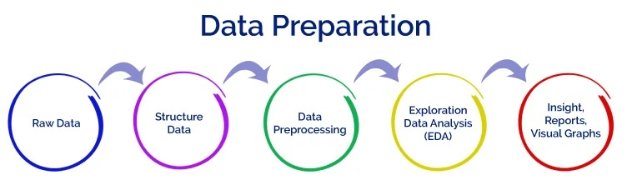
Methodology
Data collection methodology:
SpaceX Rest API
Web scraping from Wikipedia
Parse the scraped HTML tables and convert into a Pandas DataFrame ready for analysis
Data wrangling (transforming data for machine learning)
One Hot Encoding data fields for machine learning
Drop irrelevant columns and replace null values with the mean value of their respective column
Exploratory Data Analysis (EDA) using visualisation and SQL
Plotted scatter, bar, and line graphs to compare the relationships between independent variables and identify any patterns in the data
Performed interactive visual analytics using Folium and Plotly Dash
Performed predictive analysis using classification models
How to build, tune, evaluate classification models

Slide 7
Methodology
How the datasets were collected:
Using SpaceX REST API I was able to gather the SpaceX launch data, including information about the different rockets used (Falcon 1 and Falcon 9), the payloads carried, launch and landing specifications, and landing outcomes
Analysing this data will help to achieve the goal of predicting whether SpaceX Falcon 9 Stage 1 launches will successfully land or not
The SpaceX REST API endpoints, or URL, starts with api.spacexdata.com/v4/
Another popular method for obtaining Falcon 9 Launch data is by web scraping Wikipedia using Beautiful Soup
SpaceX API
Web Scraping
Use SpaceX REST API
API returns SpaceX data in .JSON format
Normalise and convert the data into a data frame or .csv file
Parse the data using Beautiful Soup
Get HTLM Response from Wikipedia
Normalise and convert the data into a data frame or .csv file

Slide 8
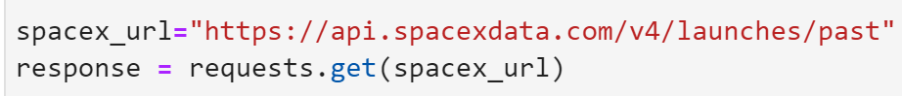
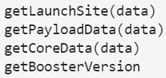
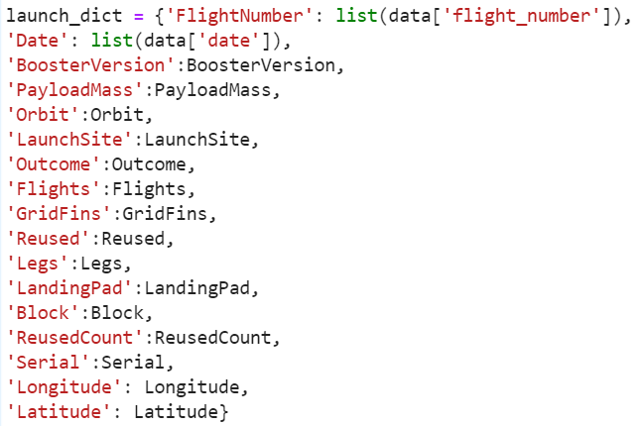
Data collection –
SpaceX API
1 . Get Response object from API
2. Converting Response to a .json file
3. Apply custom functions to clean data
4. Assign list to dictionary then data frame
5. Filter the data frame and export to .csv file
GitHub URL to Notebook

Slide 9
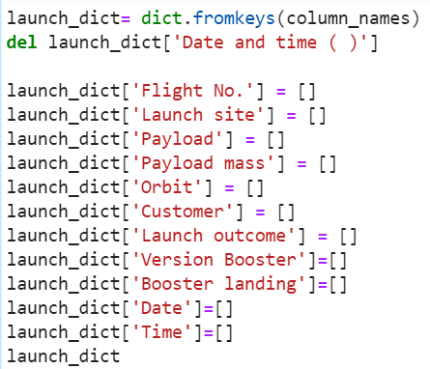
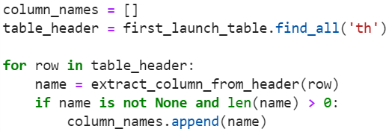
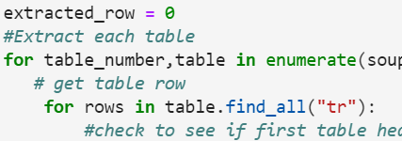
1 .Get Response object from HTML
Data collection – Web Scraping
5. Creation of dictionary
2. Creating BeautifulSoup Object
3. Find all the <table> elements
4. Getting column names
6. Appending data to keys (refer) to notebook block 12
7. Converting dictionary to data frame
8. Data frame to .csv file
GitHub URL to Notebook

Slide 10
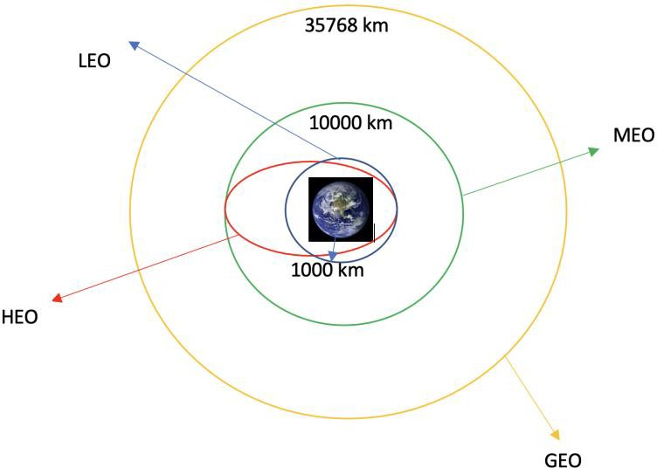
Data Wrangling
Introduction
In the data set, there are several different cases where the booster did not land successfully. Sometimes a landing was attempted but failed due to an accident. There are 3 different landing locations for the boosters, each having either a True (successful) or false (failed) outcome:
Ocean
RTLS – ground pad
ASDS – drone ship
I have converted those landing outcome values into Training Labels: 1 means the booster successfully landed and 0 means it was unsuccessful.
Each launch aims to reach a certain orbit. Here are some common orbit types:
Perform Exploratory Data Analysis (EDA) on dataset
Calculate the number of launches at each site
Calculate the number and occurrence of each orbit
Calculate the number and occurrence of mission outcome per orbit type
Export dataset as
.csv file
Create a landing outcome label from Outcome column
Work out success rate for every landing in dataset
GitHub URL to Notebook

Slide 11



EDA with Data Visualization
Scatter graphs being drawn:
Flight Number vs Payload Mass
Flight Number vs Launch Site
Payload Mass vs Launch Site
Flight Number vs Orbit Orbit VS. Payload Mass
Scatter plots show how much one variable is affected by another. The relationship between two variables is called their correlation. Scatter plots usually consist of a large body of data.
Bar graph being drawn:
Orbit vs Mean Success Rate (Class)
A bar diagram makes it easy to compare sets of data between different groups at a glance. The graph represents categories on one axis and a discrete value in the other. The goal is to show the relationship between the two axes. Bar charts can also show big changes in data over time.
Line graph being drawn:
Year vs Mean Success Rate (Class)
Line graphs are useful in that they show data variables and trends very clearly and can help to make predictions about the results of data not yet recorded.
GitHub URL to Notebook

Slide 12

EDA with SQL
Below are a list of questions I was able to answer by running different SQL queries to gather the required datasets:
Display the names of the unique launch sites in the space mission
Display 5 records where launch sites begin with the string ‘CCA’
Display the total payload mass carried by boosters launched by NASA (CRS)
Display average payload mass carried by booster version F9 v1.1
List the date when the first successful landing outcome in ground pad was achieved
List the names of the boosters which have success in drone ship and have payload mass greater than 4000 but less than 6000
List the total number of successful and failure mission outcomes
List the names of the booster_versions which have carried the maximum payload mass
List the records which will display the month names, failure landing_outcomes in drone ship ,booster versions, launch_site for the months in year 2015
Rank the successful landing_outcomes between the date 2010-06-04 and 2017-03-20 in descending order
GitHub URL to Notebook

Slide 13
Build an interactive map with Folium
To visualise the Launch Data into an interactive map, I took the latitude and longitude coordinates of each launch site and added a circle marker around each site with a label of the site’s name.
I assigned 2 different colors to the landing outcome of the launches:
- Green for launches which successfully landed (class 1)
- Red for launches which failed to land (class 0)
I was able to create a marker cluster object using the MarkerCluster plugin to show all the markers on the map in a simplified and clear display
Using Haversine’s formula I calculated the distance from the Launch Site to various landmarks to find various trends about what is around the Launch Site to measure patterns. Lines are drawn on the map to measure distance to landmarks.
Examples of some trends in which the Launch Site locations are situated:
Close proximity to railways - No
Close proximity to highways - No
Close proximity to coastline? - Yes
Certain distance away from cities? - Yes
GitHub URL to Notebook

Slide 14
Build an interactive dashboard with Plotly Dash
Using Plotly Dash I was able to create an interactive dashboard with pie charts and scatter graphs to better analyse and explain the data. Below is a summary of the graphs created and how they can be used interactively to provide a closer look at the data we have been working with.
Pie chart showing the comparison between the total successful launches for all sites as well as the success vs failure of launches for each individual site.
From these charts I can determine the following:
Site KSC LC-39A has the highest number of successful launches
Site KSC LC-39A has the highest launch success rate at 76.9%, whereas site CCAFS LC-40 has the lowest launch success rate at 26.9%
Scatter graph showing the relationship between the Launch Outcome (class 1 or 0) and Payload Mass (Kg) for the different Booster Versions.
From this graph I can determine the following:
The majority of the launches were in the payload range between 2000kg and 4000kg
Booster Version F9 B5 has the highest launch success rate of 100%, however, only 1 launch for this version has been registered
Booster Version F9 FT has the most launches with a total of 21 launches at a success rate of 67%
GitHub Link to Notebook

Slide 15

Predictive analysis (Classification)
BUILDING MODEL
Load our dataset into NumPy and Pandas
Data wrangling – transform and standardise the data
Split our data into training and test data sets
Check how many test data samples there are
Use 4 different machine learning algorithms: Logistic Regression, Decision Trees, k-nearest neighbors (KNN), and Support Vector Machines (SVM)
Use GridSearchCV to test the parameters of each classification algorithm to find the best parameters
Fit the datasets into the GridSearchCV objects and train the dataset
EVALUATING MODEL
Check accuracy for each model
Get tuned hyperparameters for each type of algorithm
Plot Confusion Matrix
IMPROVING MODEL
Feature engineering
Algorithm tuning
FINDING THE BEST PERFORMING CLASSIFICATION MODEL
The model with the highest accuracy score wins the best performing model
The accuracy (score) of the best algorithm is shared at the end of the notebook along with a dictionary of the best parameters for that algorithm
GitHub Link to Notebook

Slide 16
Results
Exploratory data analysis results
Interactive analytics demo in screenshots
Predictive analysis results

Slide 17

EDA with Visualisation

Slide 18
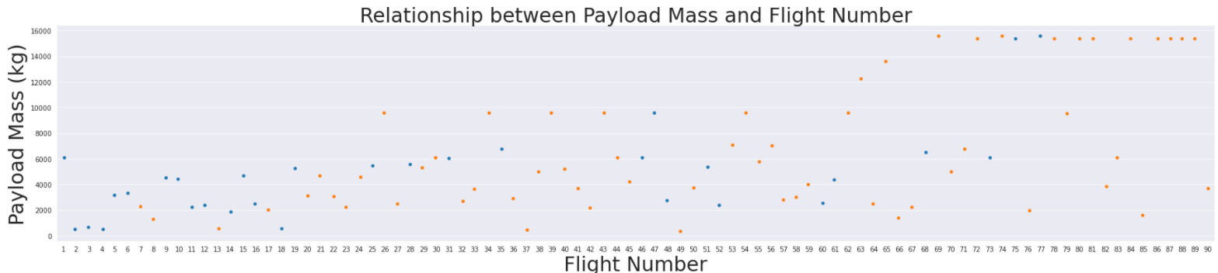
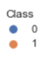
Flight Number vs. Payload Mass
This graph shows that as the number of flights increase, so does the success rate for the landing of the first stage. It’s not clear to say the same for payload mass with this graph.

Slide 19
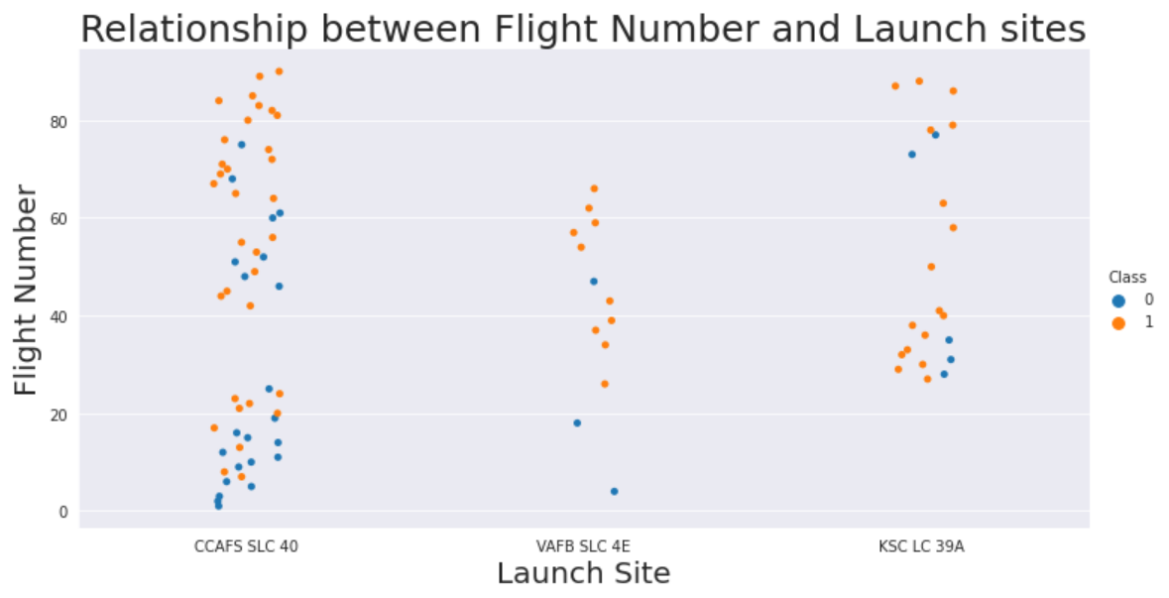
Flight Number vs. Launch Site
This graph shows the landing success rate improves at each launch site as the number of flights are increased

Slide 20
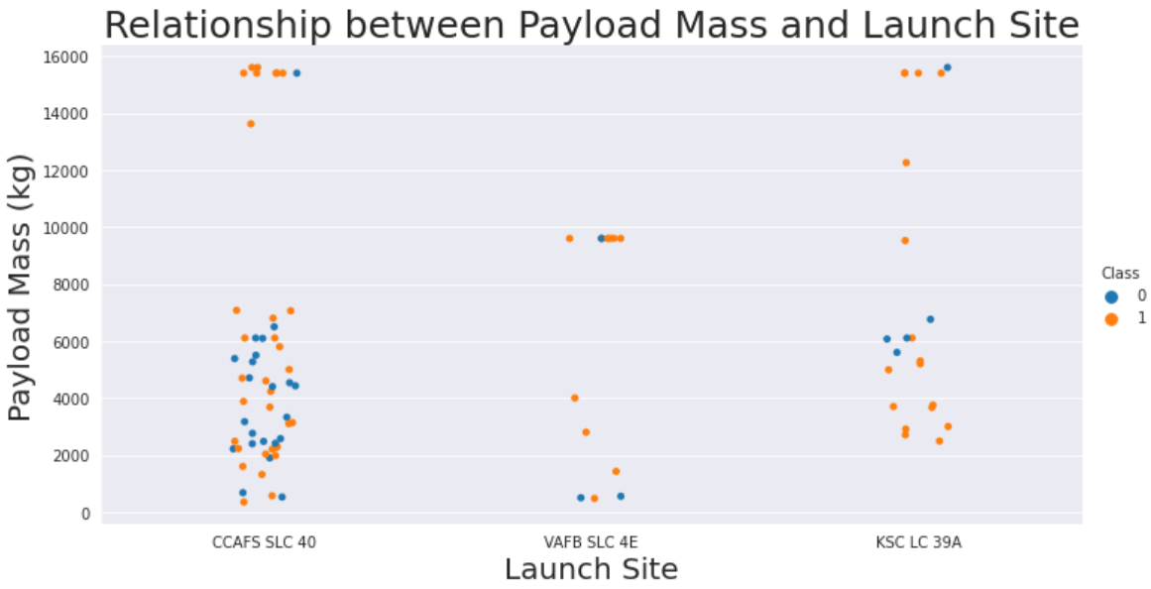
Payload Mass vs. Launch Site
This graph shows launch site CCAFS SLC 40 has a high launch success rate when the payload is very high, around 15000kg. There isn’t enough data samples for each of the sites across a broad range of payload mass values to provide a definitive answer as to whether either launch sites are dependent on payload mass for a successful launch.

Slide 21
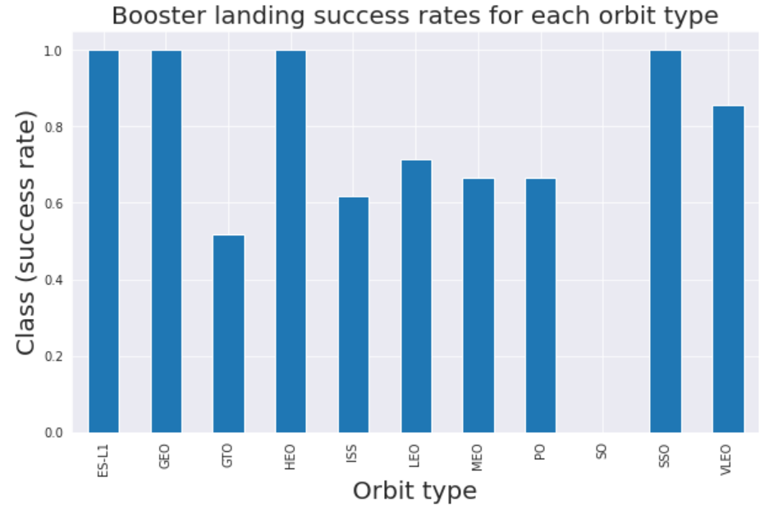
Success rate vs. Orbit type
This graph shows that orbit types ES-L1, GEO, HEO, and SSO all have the best success rate of 100%

Slide 22
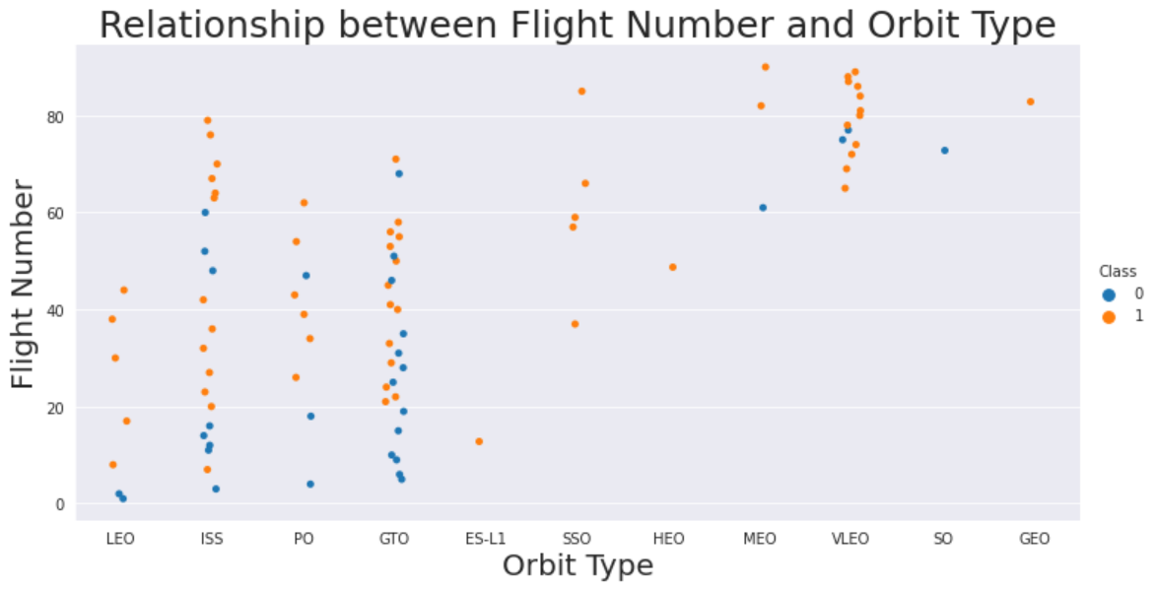
Flight Number vs. Orbit type
This graph suggests that as flight numbers increase for most of the launch sites, the launch success rate increases. This isn’t clear for all sites since some sites don’t have many data samples.

Slide 23
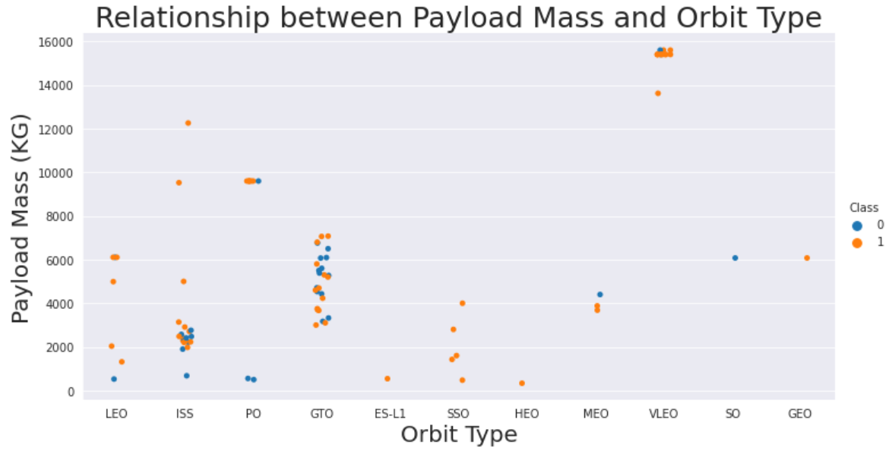
Payload vs. Orbit type
It’s not clear to show the relationship between payload mass and launch success rate for the different orbit types since there isn’t a broad range of payload mass values used for each orbit.

Slide 24
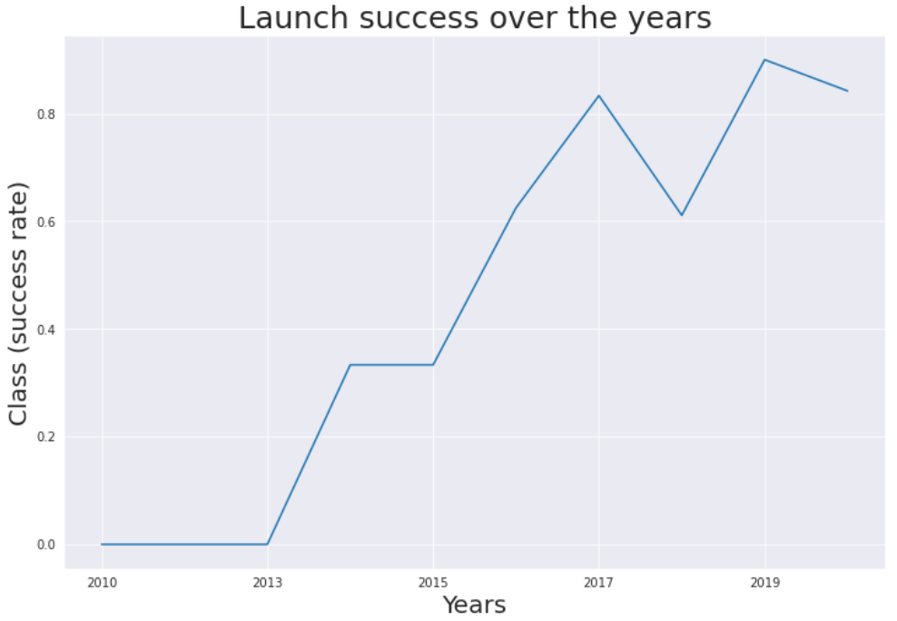
Launch success yearly trend
This graph clearly shows that the success rates over the years have been increasing, with slight drops in 2018 and 2020.
There were no successful launches until 2014.

Slide 25

EDA WITH

Slide 26
Unique Launch Sites
SQL QUERY
SELECT DISTINCT Launch_Site as "Unique_Launch_Sites" from SPACEXTBL
Unique_Launch_Sites
CCAFS LC-40
CCAFS SLC-40
KSC LC-39A
VAFB SLC-4E
QUERY EXPLAINATION
Using DISTINCT in the query means it will only show the Unique values in the Launch_Site column from spacextbl.

Slide 27
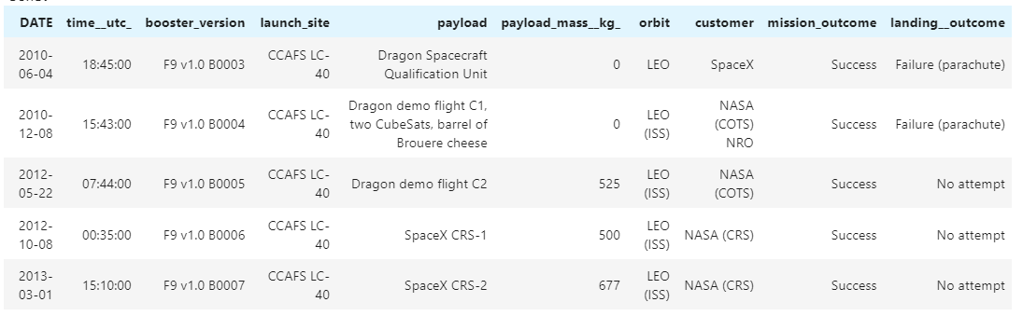
5 Launch site names beginning with 'CCA'
QUERY EXPLAINATION
Limit 5 in the query means it will only show 5 records from spacextbl. LIKE keyword with ‘CCA’ followed by ‘%’ indicates that the Launch_Site name must start with CCA.
SQL QUERY
select * from spacextbl where launch_site like 'CCA%' limit 5

Slide 28
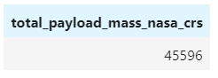
Total Payload Mass by customer NASA (CRS)
SQL QUERY
select sum(payload_mass__kg_) as "Total_Payload_Mass_NASA_CRS" from spacextbl where customer='NASA (CRS)'
QUERY EXPLAINATION
Using the function SUM calculates the total in the column PAYLOAD_MASS__KG_
The WHERE clause filters the dataset to only collect results where customer = NASA (CRS)

Slide 29
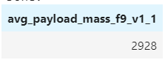
Average Payload Mass carried by booster version F9 v1.1
SQL QUERY
select avg(payload_mass__kg_) as "Avg_Payload_Mass_F9_v1_1" from spacextbl where booster_version='F9 v1.1'
QUERY EXPLAINATION
Using the function AVG calculates the average in the column
PAYLOAD_MASS__KG_
The WHERE clause filters the dataset to only perform calculations for Booster_version F9 v1.1

Slide 30
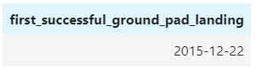
The date of the first successful landing outcome in ground pad
SQL QUERY
select min(date) as "First_Successful_Ground_Pad_Landing" from spacextbl where Landing__Outcome='Success (ground pad)'
QUERY EXPLAINATION
Using the function MIN works out the earliest/minimum date in the column Date.
The WHERE clause filters the dataset to only perform
calculations on Landing_Outcome Success (ground pad).

Slide 31
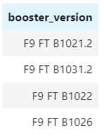
Successful drone ship landing with payload between 4000 and 6000kg
SQL QUERY
select distinct booster_version from spacextbl where landing__outcome='Success (drone ship)' and payload_mass__kg_ between 4000 and 6000
QUERY EXPLAINATION
The WHERE clause filters the dataset to show only Landing_Outcome = Success (drone ship).
The AND clause specifies additional filter conditions
Payload_MASS_KG_ > 4000 AND Payload_MASS_KG_ < 6000.

Slide 32
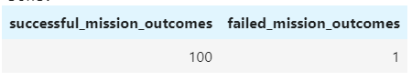
Total Number of Successful and Failure Mission Outcomes
SQL QUERY
Select count(CASE when Mission_Outcome LIKE '%Success%' then 1 end) as Successful_Mission_Outcomes, count(case when Mission_Outcome LIKE '%Failure%' then 1 end) as Failed_Mission_Outcomes from spacextbl

Slide 33
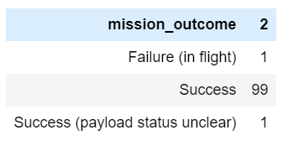
Total Number of Successful and Failure Mission Outcomes (simplified)
SQL QUERY
select Mission_Outcome, count(*) from spacextbl group by Mission_Outcome
QUERY EXPLAINATION
Count(*) to show the total number of successful and failed mission outcomes.

Slide 34
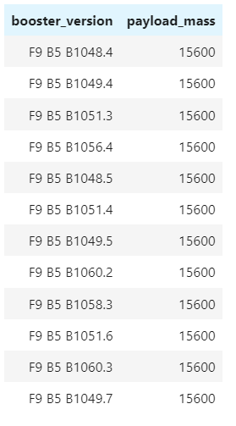
Boosters which carried maximum payload
SQL QUERY
select booster_version, PAYLOAD_MASS__KG_ as Payload_Mass from spacextbl where payload_mass__kg_ = ( select max(payload_mass__kg_) from spacextbl)
QUERY EXPLAINATION
Using a nested query to extract the MAX payload mass value to show which booster versions carried that max value.

Slide 35
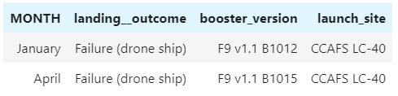
2015 Launch Records
SQL QUERY
select monthname(date) as Month, landing__outcome, booster_version, launch_site from spacextbl where landing__outcome='Failure (drone ship)' and year(date)=2015
QUERY EXPLAINATION
select monthname(date) extracts the name of the month from the values in the date column.
Year(date)=2015 extracts only those launches which occurred in the year 2015.

Slide 36
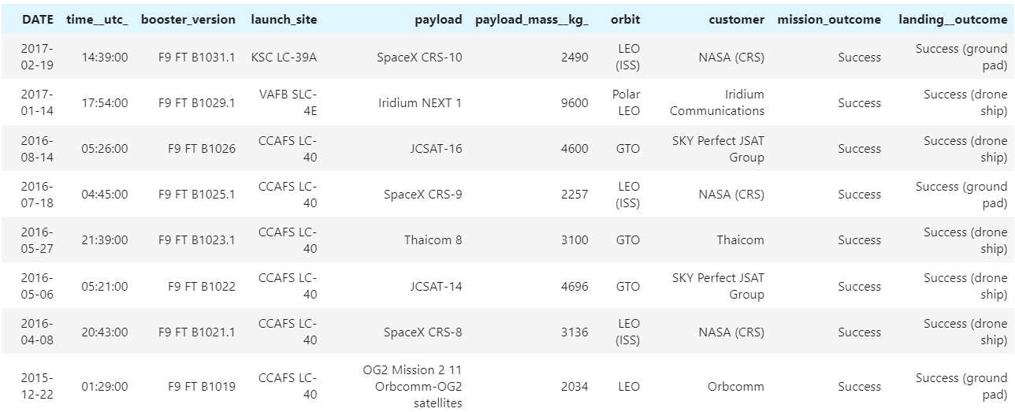
Rank success count between 2010-06-04 and 2017-03-20 in descending order
SQL QUERY
select * from spacextbl where landing__outcome like 'Success%' and date between '2010-06-04' and '2017-03-20' ORDER BY date DESC
QUERY EXPLAINATION
Order by date desc lists the values in descending order by date

Slide 37

Interactive map with

Slide 38
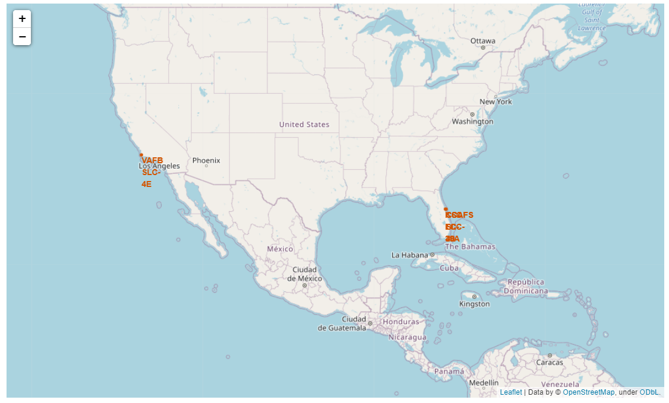
All launch sites global map markers
We can see that the SpaceX launch sites are all on the coasts of the United States of America, in Florida and California

Slide 39
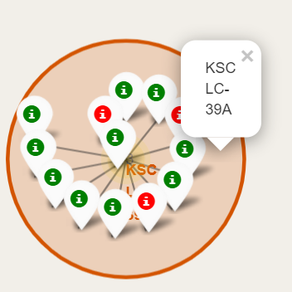
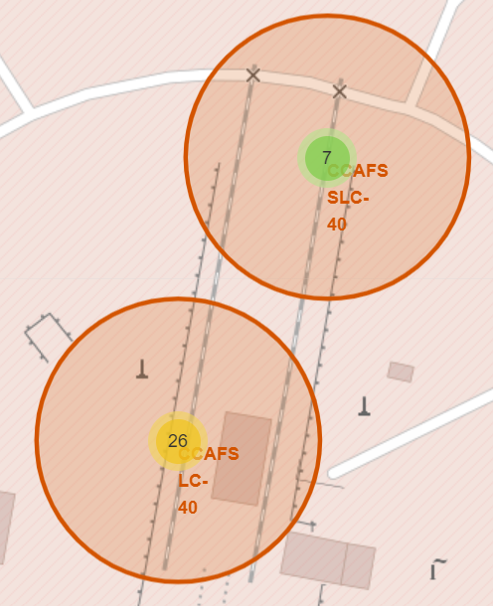
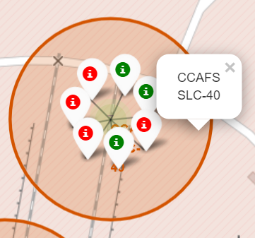
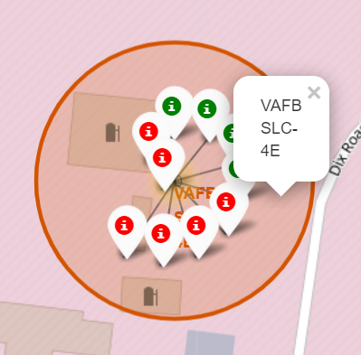
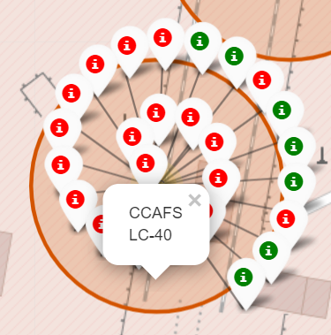
Colour Labelled Markers
California Launch Site
Green Markers show launches with successful landing outcomes.
Red Markers show launches with failed landing outcomes.
Based on these screenshots of clustered markers, we can clearly see that KSC LC-39A has the highest landing outcome success rate.
Florida Launch Sites

Slide 40
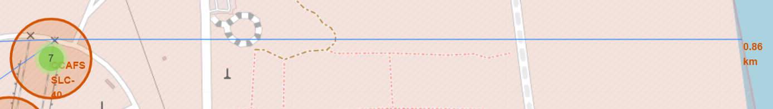
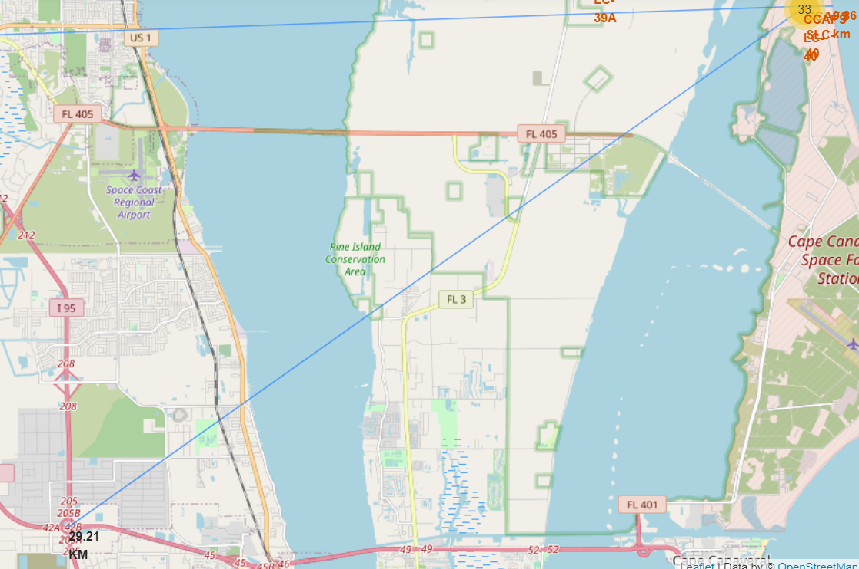
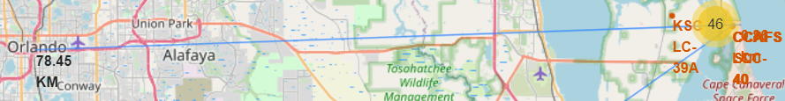
Working out Launch Sites distance to landmarks to find trends with Haversine formula using CCAFS-SLC-40 as a reference
Distance to coastline
Distance to
closest Highway
Distance to coast
Distance to city
Distance to highway
Are launch sites in close proximity to railways? No
Are launch sites in close proximity to highways? No
Are launch sites in close proximity to coastline? Yes
Do launch sites keep certain distance away from cities? Yes

Slide 41

Dashboard with

Slide 42
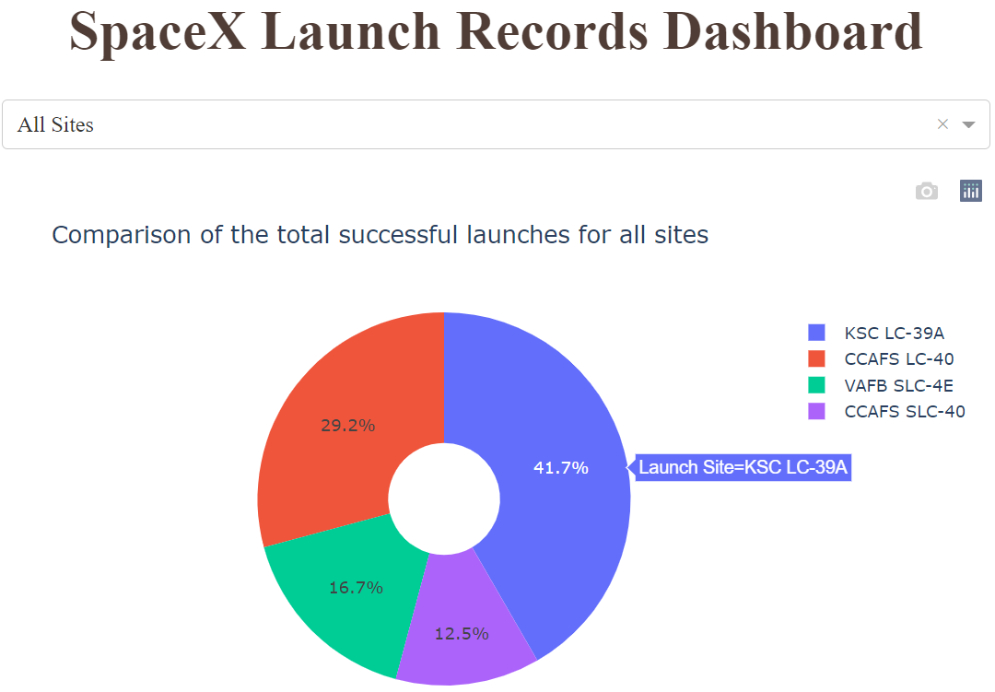
DASHBOARD – Pie chart showing the success percentage achieved by each launch site
It’s clear to see that KSC LC-39A had the most successful launches from all the sites

Slide 43
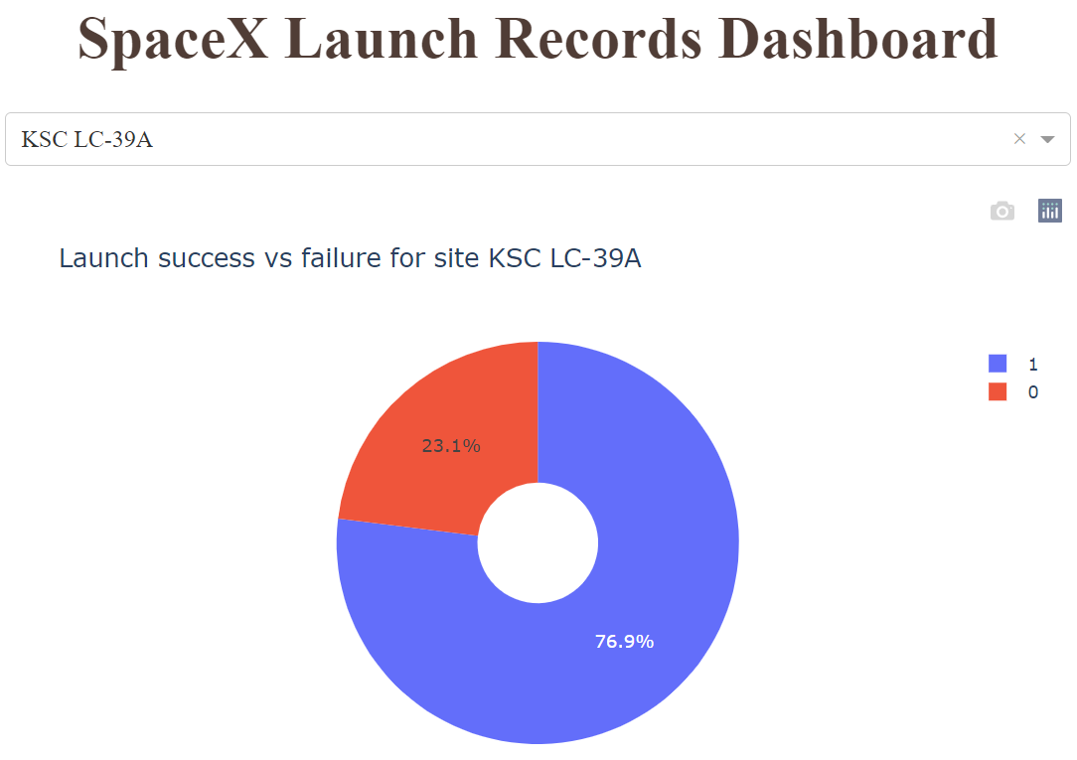
DASHBOARD – Pie chart for the launch site with highest launch success ratio
KSC LC-39A achieved a 76.9% launch success rate and had a 23.1% failure rate
Slice labels follow the values in the Class column. 1 = success, 0 = failure

Slide 44
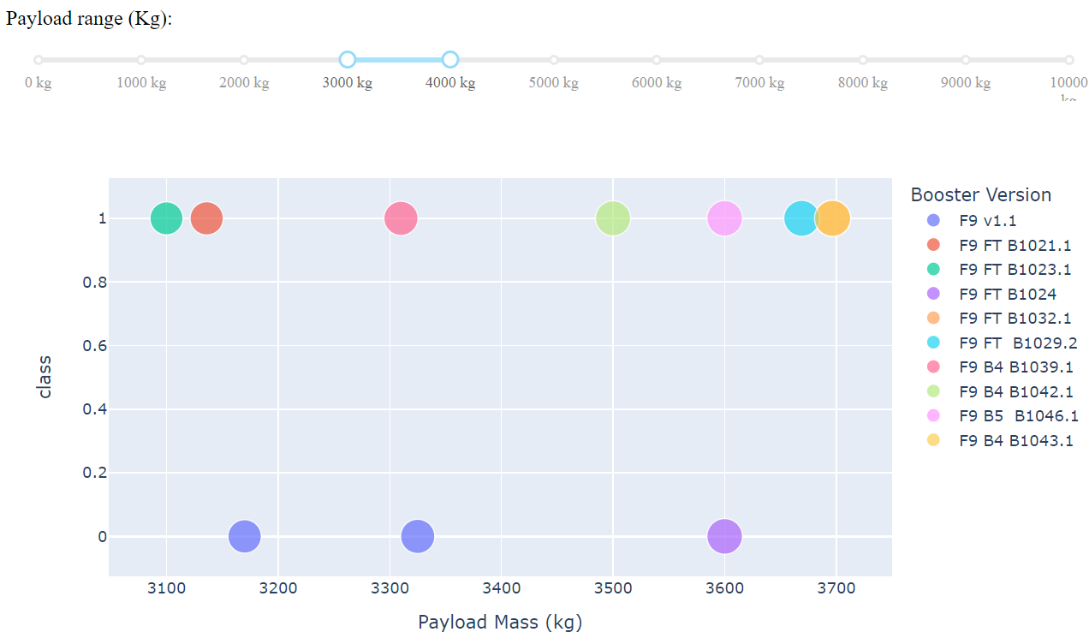
DASHBOARD – Payload vs. Launch Outcome scatter plot for all sites, with different payload selected in the range slider
Payload range 3000kg – 4000kg
This range shows the highest success rate of any of the 1000kg ranges, with a success rate of 70% (7 successful , 3 failed)

Slide 45
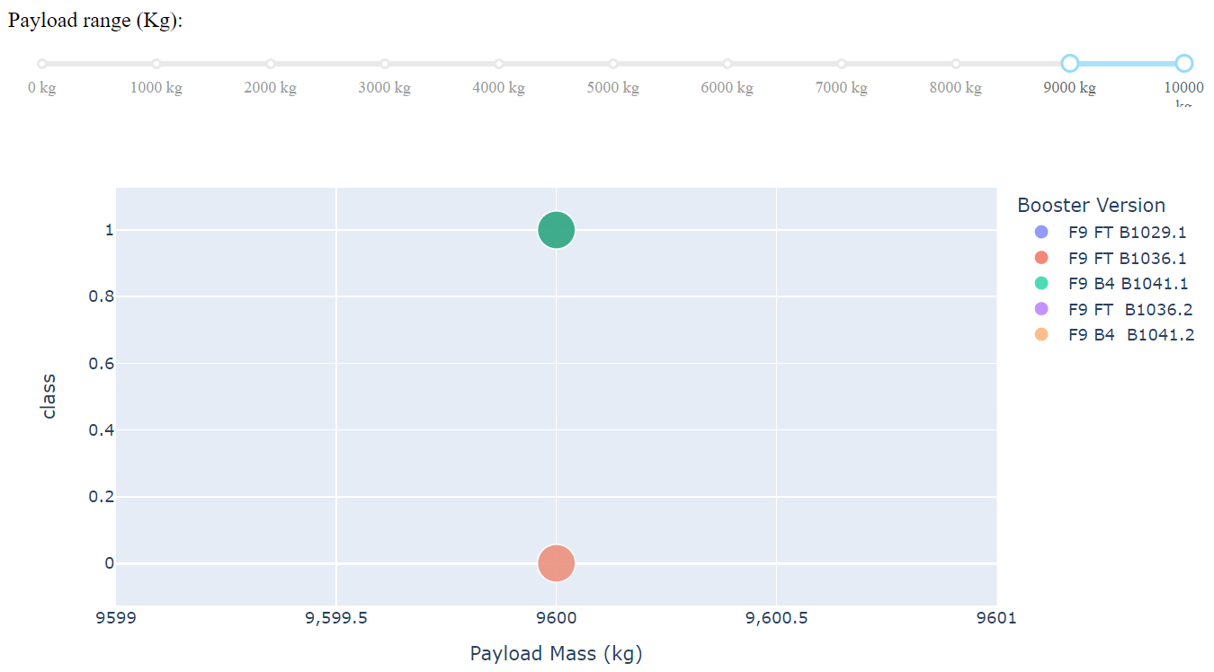
DASHBOARD – Payload vs. Launch Outcome scatter plot for all sites, with different payload selected in the range slider
Payload range 9000kg – 10000kg
This plot shows only 2 different results, successful and failed launches at 9600kg. However, the legend shows there were 5 different booster versions used for launches within this payload range. This is because all 5 launches were carried out with a payload mass of 9600kg and this scatter plot doesn’t show multiple results carried out with the same payload mass and the same landing outcome (success/failed). An improvement would be to use clustering when there are identical results for different booster versions.

Slide 46

Predictive analysis (Classification)

Slide 47
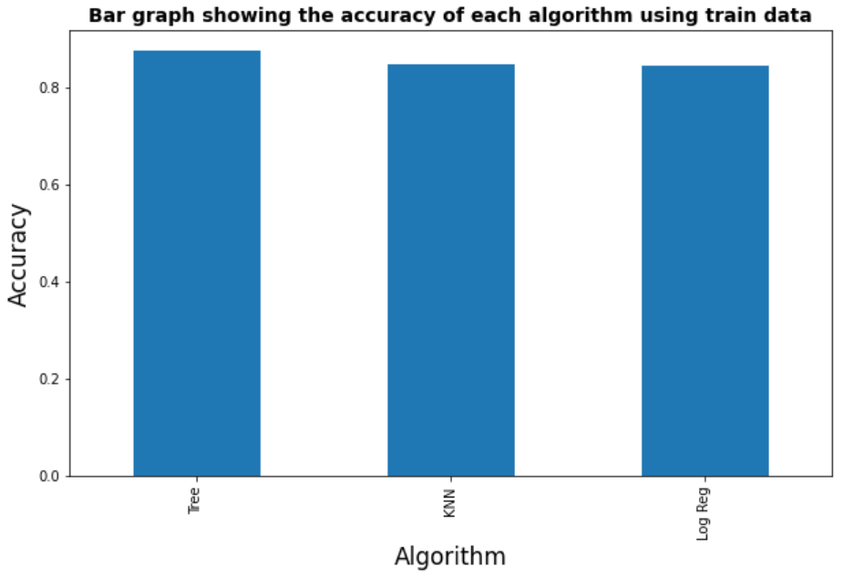
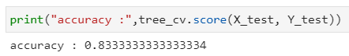
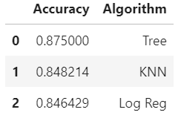
Classification Accuracy - using the test and train dataset
I was then able to select the best hyperparameters for the Decision Tree Classifier, and using the validation/test data, achieved 83.33% accuracy.
After splitting the data into train and test datasets, I was able to check the accuracy of each of the models and found them to be very similar. The winning algorithm is the Decision Tree Classifier (Tree) with an accuracy of 0.875 on the training dataset.

Slide 48
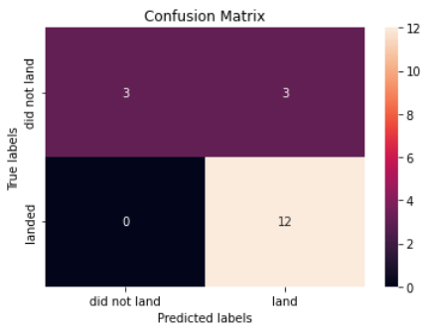
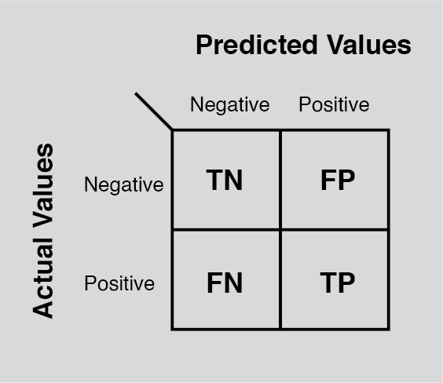
Confusion Matrix for the Decision Tree Classifier
Examining the confusion matrix, we see that Decision Tree Classifier can distinguish between the different classes. We see that the major problem is false positives.

Slide 49

Conclusion
The Decision Tree Classifier Algorithm is the best for Machine Learning for this dataset
The success rate for SpaceX launches is proportional to the flight number (continuous launch attempts) and based on this we can predict that in the following years to come, they will eventually perfect the launches and almost guarantee the first stage can be reused
There’s no clear indication whether Payload Mass affects the success rate of launches
Launch site KSC LC-39A had the most successful launches as well as the highest launch success rate
Orbit types ES-L1, GEO, HEO, and SSO all have the best success rate of 100%

